Slide 1
Demographic trends and forecasts
Insight & Intelligence Team
Jan 2025

Slide 2
Introduction
How and why the population is changing is important.
The number of older people is increasing.
Demographic shift has implications for healthcare, social care, the economy, and society as a whole.
Opportunities for older people to contribute to the labour market for longer and to be involved in their communities through activities such as volunteering.
Recent trends in fertility, mortality and migration help form a set of assumptions about how they will shape the future population.
These trends are used alongside future housing plans to forecast the population and provide a view on how the population may look if these assumptions are true.
2021 Census = a check point and led to revision of past population estimates.
Interim forecasts (2023 to 2033) – awaiting 2021 Census based ONS projections in 2025 which will enable production of longer term and local forecasts for localities and community partnership areas.

Slide 3
Key points
Increasing total population
Increasing dwellings
Increasing population is driven by people moving into the borough
Large cohorts in older age groups
Population changing in key age groups
Lower number of births and fertility than in the past
Number of children will decrease over next ten years
Increasing numbers of people of working age
Ageing population – large increase in numbers of older people
Increase in numbers of deaths
Health implications of increasing numbers of older people – increase in dementia
Care implications – increasing number of older people with care needs
Increasing number of older people living alone
Technical detail and links to national research

Slide 4
Increasing total population
Population has increased by 9% (31,600) over the last ten years (2013 to 2023) to 365,100 in 2023.
Forecast to continue to increase but at a slightly slower rate, 8% (28,500) increase over the next ten years, to 393,500 in 2033.
393,500 (in 2033)
365,100 (in 2023)
333,500 (in 2013)
Note: All numbers rounded to nearest 100.
Sources: Population estimates, Office for National Statistics licensed under the Open Government Licence v.3.0. Population forecasts, Insight and Intelligence Team, CW&C

Slide 5
Increasing dwellings
165,200 dwellings (2023)
365,100 population (2023)
New dwellings | Per annum
Adopted Local Plan (2010 to 2030) | 1,100 (minimum)
New dwellings (2013 to 2023) | 1,700 (actual built)
Housing Land Monitor 2024 forecast to 2030 | 1,000 (average pa)
New (Dec 2024) National Planning Policy Framework housing need (not included in current Adopted Local Plan) | 1,914
Assumption new dwellings 2023-33 = 1,700 pa
(includes judgements on realistic migration based on past trends and consideration of lead in time for new policy)
Sources:
Table 100: Number of Dwellings by Tenure and district, England, 2023 (provisional), MHCLG
Population estimates, Office for National Statistics licensed under the Open Government Licence v.3.0

Slide 6
Increasing population is driven by people moving into the borough
Over the last ten years (2013 to 2023):
Natural change (births – deaths) has decreased (number of births has decreased, deaths have increased)
Each year, an average 20,100 people moved into CW&C from elsewhere (17,800 from UK and 2,300 international)
Around 17,600 moved out of the borough each year (15,900 to UK and 1,700 international)
Net migration (mainly adults aged under 50 and children) is driving population increase
Recent factors affecting international migration:
New immigration system - January 2021
End of free movement from EU
Easing of restrictions after COVID-19
War in Ukraine
Changes to policies - review of shortage occupation list, increase in the salary thresholds, eligibility of dependants.
UK = mainly non-EU migrants (and dependents), coming for work – almost half came from India or Nigeria, most commonly to work in the health and social care sector.
Experts from Oxford University and LSE* expect net international migration to fall. Latest provisional ONS estimates show a decrease.
Grey area = Unattributable population change reflects adjustments needed to bring estimates in line with 2021 Census results, avg 900 pa.
LSE = London School of Economics and Political Science

Slide 7
Large cohorts in older age groups
Males
Females
Large cohort of people aged 75-79. (The post-World War 2 baby boom generation turned 77 in 2023).
Largest cohorts in 2023 are 50-54s and 55-59s.
Decreasing numbers of births over the last decade reflected in smaller cohorts of children aged 5-9 and 0-4.

Slide 8
Population change in key age groups
Estimate:
Over the last 10 years (2013 to 2023):
Forecast:
Over the next 10 years (2023 to 2033):
Population has increased by 9%
Number of children (0-15) increased by 7%
Largest increases in older age groups:
20% (13,100) increase in number of people aged 65+
25% (2,100) increase in 85+
Population is forecast to increase by 8%
Number of children forecast to decrease by 2%
Largest increases in older age groups:
22% (17,300) increase in number of people aged 65+
50% (5,200) increase in 85+ (double the rate of increase in previous decade)
 | 2013 | 2023 | Change 2013-23 | %
0-15 | 58,600 | 62,800 | 4,200 | 7%
16-64 | 209,100 | 223,400 | 14,300 | 7%
65+ | 65,800 | 78,900 | 13,100 | 20%
85+ | 8,400 | 10,400 | 2,100 | 25%
Total | 333,500 | 365,100 | 31,600 | 9%
 | 2023 | 2033 | Change 2023-33 | %
0-15 | 62,800 | 61,600 | -1,200 | -2%
16-64 | 223,400 | 235,800 | 12,400 | 6%
65+ | 78,900 | 96,100 | 17,300 | 22%
85+ | 10,400 | 15,600 | 5,200 | 50%
Total | 365,100 | 393,500 | 28,500 | 8%
Note: Numbers independently rounded to nearest 100.

Slide 9
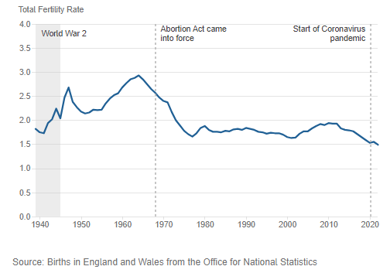
Lower number of births and fertility
Number of live births have (generally) decreased in Cheshire West and Chester over the last ten years from around 3,600 in 2013 to around 3,100 in 2023. Total fertility rates have also decreased to a record low (1.38 in 2023).
Office for National Statistics (ONS) project the fertility rate will remain at a long-term low level (around 1.5), this assumption (with a CW&C adjustment factor) is used in the CW&C population forecasts.
This may be an optimistic assumption given recent decreases in fertility rates.
Total fertility rate in England and Wales
Note: Fertility assumptions sourced from ONS 2021-based Interim National Population Projections (ONS).

Slide 10
Children (0-15) will decrease over next ten years
Numbers of children increased by 7% (4,200) over the last decade (2013 to 2023), with 17% increase in children aged 11-15.
Over the next ten years (2023 to 2033):
2% (1,200) decrease in children.
Pre-school children (aged 0-3) will increase by 6% (800).
Children aged 4-10 will decrease by 4% (1,100).
Children aged 11-15 will decrease by 4% (900).
 | 2013 | 2023 | 2033 | Change 2013-2023 | % | Change 2023-2033 | %
0-3 | 14,900 | 13,800 | 14,600 | -1,100 | -7% | 800 | 6%
4-10 | 25,500 | 27,800 | 26,700 | 2,300 | 9% | -1,100 | -4%
11-15 | 18,200 | 21,200 | 20,300 | 3,000 | 17% | -900 | -4%
0-15 | 58,600 | 62,800 | 61,600 | 4,200 | 7% | -1,200 | -2%
Note: Cohorts generally reflect past birth trends (plus annual net migration). Over the past decade each cohort of children has grown year on year due to positive net migration.
This is forecast to continue. Future fertility assumptions in the forecasts may be overly optimistic. If there was a lower number of births over the next ten years than forecast there would be a lower number of children aged 0-10.

Slide 11
Increasing numbers of people of working age
Slightly lower increase in people of working age compared to the previous decade.
From 2013 to 2023 the number of people aged 16-64 increased by 7% (14,300), between 2023 to 2033 it is forecast to increase by 6% (12,400).
Numbers of people of younger working age will increase over the next ten years (partly due to net migration in younger age groups), whilst numbers of people of older working age, will remain fairly constant.
 | 2013 estimate | 2023 estimate | 2033 forecast | Change 2013-2023 | % | Change 2023-2033 | %
16-44 | 117,200 | 125,800 | 137,600 | 8,600 | 7% | 11,900 | 9%
45-64 | 91,900 | 97,700 | 98,200 | 5,800 | 6% | 500 | 1%
16-64 | 209,100 | 223,400 | 235,800 | 14,300 | 7% | 12,400 | 6%

Slide 12
Ageing population – large increase in numbers of older people
The number of people aged 65+ increased by 20% over the last decade (2013 to 2023).
Number of people aged 65+ is forecast to increase by 22% (17,300) over the next ten years.
Largest percentage increase of around 50% (5,200) is in 85+ population as WWII baby boomers move into this age group.
 | 2013 estimate | 2023 estimate | 2033 forecast | Change 2013-2023 | % | Change 2023-2033 | %
65-74 | 36,200 | 39,600 | 48,600 | 3,400 | 9% | 9,000 | 23%
75-84 | 21,300 | 28,900 | 31,900 | 7,600 | 36% | 3,000 | 10%
85+ | 8,400 | 10,400 | 15,600 | 2,100 | 25% | 5,200 | 50%
65+ | 65,800 | 78,900 | 96,100 | 13,100 | 20% | 17,300 | 22%
Note: ONS assume there will not be a step change in future mortality improvement rates as a result of COVID-19. The forecasts assume the same mortality improvement factors as the 2021-based Interim National Population Projections (ONS).

Slide 13
Increase in numbers of deaths
The number of deaths has increased from around 3,200 in 2013 to 3,900 in 2023.
The number of deaths will continue to increase over the next ten years, as the older population increases.
By 2033, there are forecast to be over 4,300 deaths a year.
There may be implications and pressure points for end-of-life care, services and support.

Slide 14
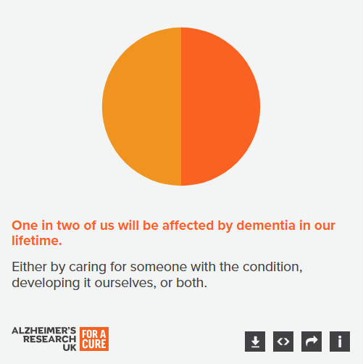
Health implications of increasing number of older people – increase in dementia
The number of people with dementia in the borough is forecast to increase by 29% (1,700) over the next ten years.
More than half this increase (1,100) will be in people aged 80+.
Around 200 additional people are forecast to have severe dementia by 2032 – this may increase demand for residential care. The Alzheimer’s Society estimate two-thirds (66%) of people with severe dementia live in residential or nursing care settings.
The largest increases are most likely in deprived areas – national prevalence rates are nearly twice as high for those living in the most deprived areas compared to those in the least deprived areas.
 | 2023 estimate | 2033 forecast | Change 2023-2033 | %
Mild | 2,900 | 3,700 | 800 | 29%
Moderate | 2,200 | 2,800 | 600 | 29%
Severe | 800 | 1,000 | 200 | 29%
Total | 5,800 | 7,500 | 1,700 | 29%
Source of prevalence: The annual cost of dementia, Alzheimer’s Society, 2024

Slide 15
Care implications – increasing number of older people with care needs
Largest increase forecast in the number of older people (aged 65+) living independently
Large increase in number of older people with low dependency needs
People with medium or high dependency and requiring substantial care (daily or 24 hour) will increase with greatest increase (1,000) in high dependency (24 hour care needs).
Increasing needs are predominantly in people aged 85+ reflecting population increases in this cohort
 | 2023 estimate | 2033 forecast | Change 2023-2033 | %
Independent | 49,300 | 61,000 | 11,600 | 24%
Low dependency | 20,100 | 24,700 | 4,600 | 23%
Medium dependency | 3,600 | 3,600 | 100 | 2%
High dependency | 5,800 | 6,900 | 1,000 | 17%
Source of prevalence: Lancet Public Health article - Forecasting the care needs of the older population in England over the next 20 years: estimates from the Population Ageing and Care Simulation (PACSim) modelling study, Andrew Kingston, Adelina Comas-Herrera, Carol Jagger for the MODEM project, Forecasting the care needs of the older population in England over the next 20 years: estimates from the Population Ageing and Care Simulation (PACSim) modelling study - The Lancet Public Health. The MODEM project is also used by Alzheimer’s Society for prevalence rates.

Slide 16
Increasing number of older people living alone
10% (16,200) additional households forecast by 2033, less than growth in previous decade (12%).
Highest growth is in lone pensioner households, with an additional 5,000 older people living alone by 2033.
18% (4,600) increase in other household types (households that are neither single person or family households).
 | 2013 | 2023 | 2033 | Change 2013-2023 | % | Change 2023-2033 | %
One-person household Aged 0 to 65 | 23,800 | 26,100 | 27,100 | 2,200 | 9% | 1,000 | 4%
One-person household Aged 66 years and over | 18,300 | 22,600 | 27,600 | 4,300 | 23% | 5,000 | 22%
Couple family household - All children non-dependent | 9,500 | 10,600 | 11,100 | 1,100 | 12% | 500 | 5%
Couple family household - Dependent children | 28,300 | 29,700 | 32,300 | 1,400 | 5% | 2,600 | 9%
Couple family household - No children | 25,900 | 29,000 | 30,200 | 3,100 | 12% | 1,200 | 4%
Single family household - Lone parent household | 14,700 | 16,000 | 17,300 | 1,300 | 9% | 1,300 | 8%
Other household types | 21,500 | 25,700 | 30,300 | 4,200 | 20% | 4,600 | 18%
Total | 142,000 | 159,700 | 175,900 | 17,700 | 12% | 16,200 | 10%

Slide 17
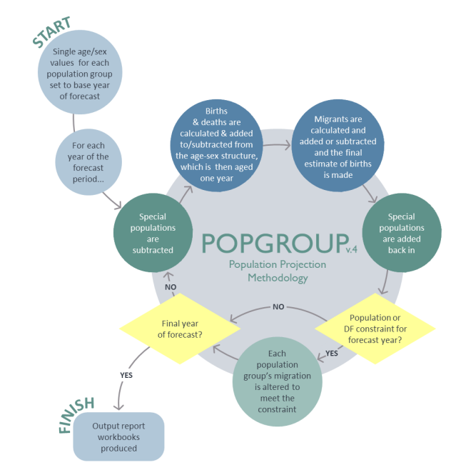
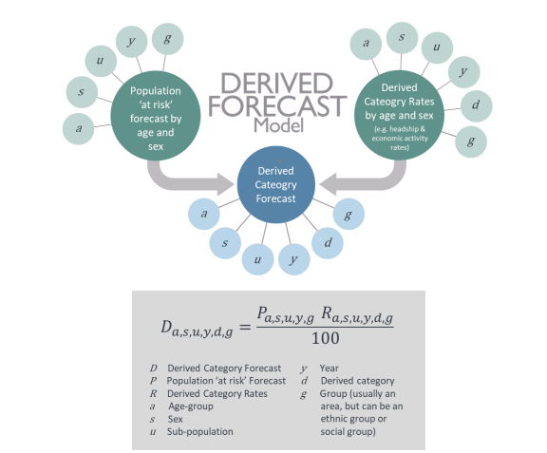
Technical detail and links to national research
Particularly difficult time to produce forecasts due to a range of factors – changes in planning policy, immigration trends, fertility trends
Ten years – Interim forecasts
Forecasts become less accurate the further into the future they go
Produced using Popgroup model (LGA owned) = cohort component model with derived forecasts model
Caveats – forecasts based on a range of assumptions (some pre 2021 Census)
2021-based Interim National Population Projections (ONS) – trends in fertility, mortality – adjusted to local rates
2021 Census
1,700 new dwellings pa = average 2012/13 to 2022/23
New demographic information (National and Subnational population and household projections) due in 2025 – opportunity to update borough forecasts and produce local forecasts
National research on implications of ageing population:
Future of an ageing population - GOV.UK (www.gov.uk)
Chief Medical Officer’s annual report 2023: health in an ageing society - GOV.UK (www.gov.uk)
Health in 2040: projected patterns of illness in England - The Health Foundation
Notes and sources: All data is independently rounded to nearest 100. Population estimates, Office for National Statistics licensed under the Open Government Licence v.3.0
Population forecasts, Insight and Intelligence Team, CW&C.
Contact: insight@cheshirewestandchester.gov.uk Insight & Intelligence Team, Cheshire West & Chester Council.

